Slide 1

Green Pace
Security Policy Presentation
Developer: Johnny Canal Segura

Slide 2

OVERVIEW: DEFENSE IN DEPTH
Defense in Depth creates a layered defense against attacks. These multiple layers make it so attackers have to breach multiple layers of protection to gain access making them less likely to continue the attack and often making them move on to a weaker target.

Slide 3
THREATS MATRIX
Likely STR51-CPP MEM56-CPP MEM521-CPP | Priority P18 P18 P1
Low priority P6 P1 P2 | Unlikely INT50-CPP DCL03-C OOP50-CPP
Threats should be addressed in order of severity and likelihood.
Lower-threat vulnerabilities should not require as many resources and attention as bigger threats.

Slide 4
10 PRINCIPLES
Validate Input Data
Data type
Data value
String correctness
Input Output
2. Heed Compiler Warnings
SQL Injection
Assertions
Exceptions
3. Architect and Design for Security Policies
Exceptions
String correctness
SQL Injection
4. Keep it Simple
Input output
String correctness
Data type
5. Default Deny
Exceptions
SQL Injection
Input output
6. Adhere to the Principle of Least Privilege
Exceptions
SQL Injection
Assertions
7. Sanitize Data Sent to Other Systems
Input output
String correctness
Assertions
8. Practice Defense in Depth
SQL Injection
Exceptions
Data type
Input output
9. Use Effective Quality Assurance Techniques
Input output
String correctness
Data type
10. Adopt a Secure Coding Standard
SQL Injection
Input output
Exceptions

Slide 5
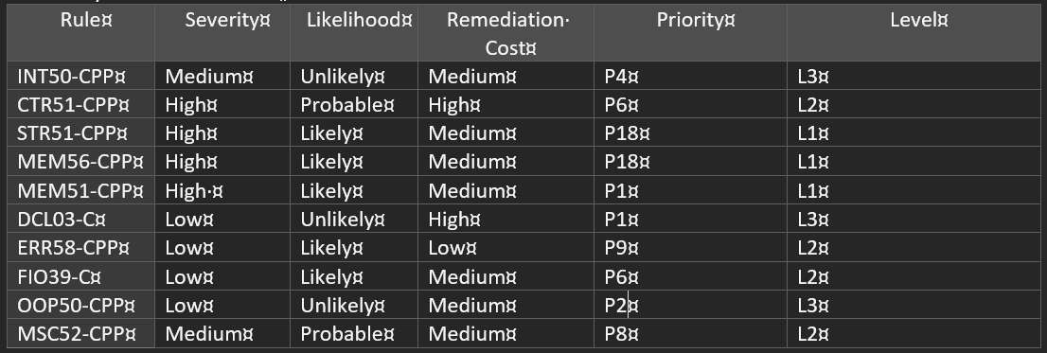
CODING STANDARDS

Slide 6
ENCRYPTION POLICIES
Encryption at rest:
Encryption at rest is encryption that takes place when data is stored on a device. This works with all data that is stored or archived in a database within Green Pace’s systems. Encryption at rest prevents attacks when unauthorized access occurs. This type of encryption should be used on all sensitive data.
Encryption in flight:
Encryption in flight secures data while it is in transit to another device or network. This transfer can happen via the internet, intranet, or extranet. This can help prevent unauthorized interception of data. This process should be followed during any transfer of data including but not limited to emails, file transfers, and remote access sessions.
Encryption in use:
Encryption in use is encryption that happens during active access or usage of data in the database. Encryption in use ensures that only usage and access is only conducted by authorized personnel. This protects sensitive data from inside threats and attacks.

Slide 7
TRIPLE-A POLICIES
Authentication
Authentication verifies the identity of authorized users that access the same and the data within.
Authorization
Authorization ensures that only authorized users access the system. This step also determines access based on granted permissions.
Accounting
Accounting monitors usage and history of system usage and access. This ensures that usage is conducted compliant and secure manner.

Slide 8
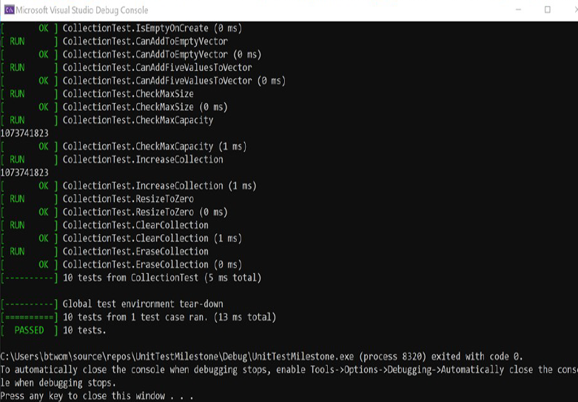
Unit Testing
Unit testing is an important part of the entire development process. This ensures that we identify potential vulnerabilities throughout the development process.

Slide 9

AUTOMATION SUMMARY

Slide 10
TOOLS
DEVSECOPS: is a framework that integrates security into all phases of the software development lifecycle.
CPPCheck: static code analysis (https://cppcheck.sourceforge.io/)
Clang: front-end compiler (https://clang.llvm.org/)
Parasoft: automated testing suite (https://www.parasoft.com/)

Slide 11
RISKS AND BENEFITS
Act now: Acting now allows developers to focus less time later in the development process to finding vulnerabilities. Weaknesses are also more difficult to uncover later in the development process.
Act later: Waiting until the end of the development process to focus on security will save time initially but this saved time will cause greater delays later in the process.

Slide 12
RECOMMENDATIONS
The more layers that we add to security the less likely an attacker is to make attempts to exploit a system.
Penetration testing can help to identify vulnerabilities by taking the approach of an attacker.

Slide 13
CONCLUSIONS
The most important takeaway in security is to ensure we practice secure coding throughout the entire development process. We must practice defense in depth to create layered protection of systems which makes them less likely to be exploited.

Slide 14
REFERENCES
Microsoft. (2024). Microsoft Security. Retrieved from Microsoft: https://www.microsoft.com/en-us/security/business/security-101/what-is-devsecops
NIST. (2024, July 30). Secure Software Development Framework. Retrieved from Computer Security Resource Center: https://csrc.nist.gov/Projects/ssdf
OWASP. (2024). Secure Coding Practices. Retrieved from Owasp: https://owasp.org/www-project-secure-coding-practices-quick-reference-guide/

